Slide 1
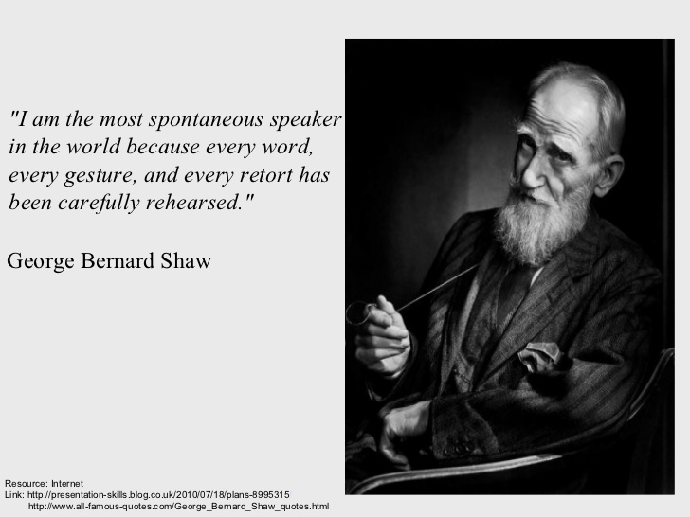
Non-Verbal Communication

Slide 2
What is Non-Verbal Communication?
“The most important thing in communication is hearing what isn’t said”- Peter Drucker
Communication without words
Sending and receiving wordless messages
Individuals convey information about their emotions, needs, intentions, attitudes, and thoughts without the use of verbal language

Slide 3
Relevance
“Nonverbal communication forms a social language that is in many ways richer and more fundamental than our words”- Leonard Mlodinow
‘The most important thing is to hear what isn’t being said.’ – Peter F. Drucker
93% - Non-Verbal (38% - tone of voice/ 55% -facial expression and posture)
7% - Verbal

Slide 4
Continued
Complementing Verbal Communication and better understanding of the message
Regulating conversations
Universal non-verbal cues help to overcome linguistic barriers
Increases workplace efficiency
Trust and credibility reinforcement
Helps to communicate with people with hearing disability

Slide 5
Types
Body language (kinesics)
Distance (proxemics)
Non-verbal elements that accompany spoken language-tone, volume, pitch of voice, speech rates, pauses (paralanguage)
Touch (haptics)
Time (chronemics)
Eye contact and the actions of looking while talking and listening, frequency of glances, patterns of fixation, pupil dilation, and blink rate (oculesics)

Slide 6
Kinesics
Developed by the American Anthropologist Ray L. Birdwhistell
Concerned with the interpretation of non-verbal behaviors like movements, facial expressions, gestures, posture

Slide 7
Head movement and Posture
Shaking of head from side to side – universal ‘no’
Innate meaning – babies' rejection of food
Nod – universal sign of acknowledgement
Head tilt – interest
Head down – negative or submissive attitude
How you walk, sit, stand, hold your head – personality and about you
Defensive: crossed arms
Shyness: walking with your head down
Straight posture allows you to breathe better. No slouching, leaning, or lounging!

Slide 8
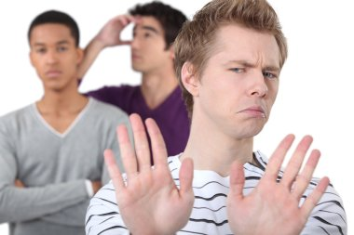
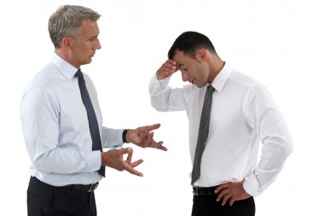
Types of posture
standing, sitting, squatting, and lying down
Within each of these postures there are many variations, and when combined with particular gestures or other nonverbal cues they can express many different meanings.

Slide 9

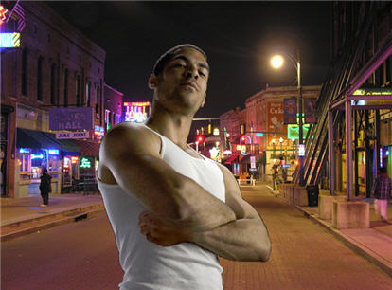



Slide 10
Gestures
adaptors, emblems, and illustrators (Andersen, 1999)
Pointing finger / hand
Sticking tongue out – welcome in Polynesia
Clapping – applause (USA)/ call a waiter (Spain)
Upward and downward nod
Simple gestures make us feel and sound confident and comfortable!

Slide 11
Adaptors are touching behaviors and movements that indicate internal states typically related to arousal or anxiety.
Adaptors can be targeted toward the self, objects, or others.
In regular social situations, adaptors result from uneasiness, anxiety, or a general sense that we are not in control of our surroundings.
Many of us subconsciously click pens, shake our legs, or engage in other adaptors during classes, meetings, or while waiting as a way to do something with our excess energy.
Public speaking students who watch video recordings of their speeches notice nonverbal adaptors that they didn’t know they used.
In public speaking situations, people most commonly use self- or object-focused adaptors.
Common self-touching behaviors like scratching, twirling hair, or fidgeting with fingers or hands are considered self-adaptors.
Some self-adaptors manifest internally, as coughs or throat-clearing sounds.

Slide 12
Emblems are gestures that have a specific agreed-on meaning. These are still different from the signs used by hearing-impaired people or others who communicate using American Sign Language (ASL).
Emblems can be still or in motion; for example, circling the index finger around at the side of your head says “He or she is crazy,” or rolling your hands over and over in front of you says “Move on.”
OK symbol – zero- none- obsenity

Slide 13
Illustrators are the most common type of gesture and are used to illustrate the verbal message they accompany.
For example, you might use hand gestures to indicate the size or shape of an object. Unlike emblems, illustrators do not typically have meaning on their own and are used more subconsciously than emblems.
These largely involuntary and seemingly natural gestures flow from us as we speak but vary in terms of intensity and frequency based on context.
Although we are never explicitly taught how to use illustrative gestures, we do it automatically.
Think about how you still gesture when having an animated conversation on the phone even though the other person can’t see you.

Slide 14
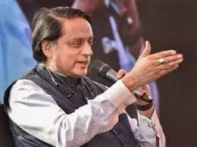
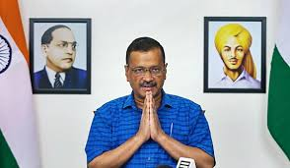
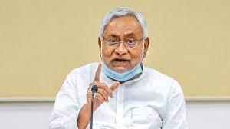

Slide 15
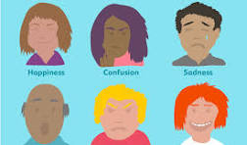
Affect Displays
displays of the body or face that carry an emotional meaning
gait (bouncing, suggesting happiness for instance, or slouched and shuffling, suggesting depression),
facial movements (breaking into a big grin, suggesting pleasure, or frowning suddenly indicating displeasure)

Slide 16
Regulators
accompany speech to control or regulate what the speaker is saying
associated with turn-taking in conversation, influencing the flow and pace of discussion
Nodding head
Moving away
Raising a hand or a finger

Slide 17
Chronemics
Study of how time is used in communication
The way in which one perceives and values time, structures time, and reacts to time frames communication
Time perception and its important role across cultures
Time perception: punctuality, willingness to wait, and interactions
Monochronic and polychronic cultures

Slide 18
Classification
Biological: rhythm of living things – circadian rhythm
a daily cycle that influences when we eat, sleep, and wake
personal,: the ways in which individuals experience time - based on our mood, our interest level, and other factors
Physical: fixed cycles of days, years, and seasons – season can affect our mood and psychological state
cultural time: how a large group of people view time – polychronic and monochronic

Slide 19
Continued
A monochronic time system means that things are done one at a time and time is segmented into precise, small units
A polychronic time system is a system where several things can be done at once, and a more fluid approach is taken to scheduling time.
Examples of polychronic behaviors include: cooking food while watching television or browsing the internet while sitting in meetings

Slide 20
Paralanguage
Pitch
Tone
Speed of speaking
Pace
Pause

Slide 21
Continued
How do you say the words?
The word ok can have different meanings depending on how you say it
Vocal characteristics: pitch, volume, rate, voice quality
Vocal Interferences: the sounds and words we use when we hesitate

Slide 22
Pitch
High or the low in tone
We are able to make our voices get higher or deeper (change the pitch of our voices) by altering the shape of our vocal cords (or vocal folds).
When our vocal cords are stretched out more, they vibrate more slowly as air passes through them. This slower vibration causes a lower or deeper sound.
When our vocal cords are shorter and thinner, the vibration is faster, creating a higher-pitched sound.

Slide 23
Volume
Loudness or softness of speech
Volume is one of the most vital elements of any speech. If your voice does not reach the audience, it becomes much harder for your content to resonate with the audience
Emphasizes key points
Draws the attention of the audience
Start strong – end strong

Slide 24
Rate
Speed at which a person speaks
A good rate of speech ranges between 140 -160 words per minute (wpm). A rate higher than 160 words per minute can be difficult for the listener to absorb the material.
Too slow of a rate may give the listener the perception of slow thinking, incompetence and being uneducated.
Humor, and light, frivolous messages are best expressed at a faster rate because we process that information a lot quicker.
When determining the rate of speech you want to use, analyze the content of your message.

Slide 25
intonation
Inflection in a person’s voice
falling intonation, rising intonation and fall-rise intonation
Falling intonation is the most common intonation pattern in English. It is commonly found in statements, commands, wh-questions (information questions), confirmatory question tags and exclamations.
Nice to meet ➘ you.
I’ll be back in a ➘ minute.
Write your name ➘ here.
Show me what you’ve ➘ written.

Slide 26
Rising Tone
Rising intonation invites the speaker to continue talking. It is normally used with yes/no questions, and question tags that are real questions.
Do you like your new ➚ teacher?
Have you finished ➚ already?
May I borrow your ➚ dictionary?
Do you have any ➚ magazines?
We've met already, ➚ haven't we?
You like fish, ➚ don't you?
You're a new student ➚ aren't you?

Slide 27
Rise- Fall
choices, lists, unfinished thoughts and conditional sentences.
Choices (alternative questions.)
Are you having ➚ soup or ➘ salad?
Is John leaving on ➚ Thursday or ➘ Friday?
Does he speak ➚ German or ➘ French?
Is your name ➚ Ava or ➘ Eva?
Lists (rising, rising, rising, falling) Intonation falls on the last item to show that the list is finished.
We've got ➚ apples, pears, bananas and ➘ oranges
The sweater comes in ➚ blue, white, pink and ➘ black
I like ➚ football, tennis, basketball and ➘ volleyball.
I bought ➚ a tee-shirt, a skirt and a ➘ handbag.
Unfinished thoughts (partial statements) In the responses to the following questions, the rise-fall intonation indicates reservation. The speaker hesitates to fully express his/her thoughts.
Do you like my new handbag? Well the ➚ leather is ➘ nice... ( but I don't like it.)
What was the meal like? Hmm, the ➚ fish was ➘ good... (but the rest wasn't great).

Slide 28
Fall-Rise
show that the speaker is not certain of the answer they are giving to a question, or is reluctant to reply (as opposed to a falling tone used when there is no hesitation). It is also used in polite requests or suggestions.
Hesitation/reluctance:
So you'd be willing to confirm that? ...Well ... I ➘sup➚pose so ...
You didn't see him on Monday? I don't quite ➘re➚member ...
Politeness-Doubt-Uncertainty: (You are not sure what the answer might be.)
Perhaps we could ➘vis➚it the place?
Should we ➘cop➚y the list?
Do you think it's ➘al➚lowed?

Slide 29
Culture & Non-Verbal communication
Norms of nonverbal communication vary from country to country and also among cultures within a particular country
Bowing is common in Asian cultures for greeting while handshake is most common form of greeting in western cultures
Sitting with crossed legs: offensive in Turkish culture

Slide 30
Continued
Curling the index finger with the palm facing up is a common gesture in United States and parts of Europe for calling someone but it is very rude in China, East Asia and many other parts of the world
In many Asian, African, and Latin American countries, unbroken eye contact would be considered aggressive but in most western countries, eye contact is a sign of confidence and attentiveness
There are also gender rules around eye contact

Slide 31
Things to Remember
Culturally determined
May conflict with verbal messages
Largely unconscious
Shows your feelings and attitudes

Slide 32
Links of videos
https://www.youtube.com/watch?v=fLaslONQAKM
https://www.youtube.com/watch?v=38y_1EWIE9I&list=PLcX7TDig6sB5VduGjsgXeyNzZhPbmQDso
https://www.youtube.com/watch?v=W3P3rT0j2gQ
https://www.youtube.com/watch?v=VRJzvJ5XPQI

Slide 33
Thank you!!

